Slide 1

EDA – Case Study
Rashmi Bharti Reshma C

Slide 2
Problem Statement
There is a consumer finance company which specializes in lending various types of loans to urban customers.
There are two types of risks involved here.
One risk is if the applicant is likely to pay the loan, then not approving the loan will cause financial loss.
Another risk is if the applicant is not likely to repay the loan (defaulted case), then approving them can cause financial loss.
The aim of the case study is to identify the persons who are likely to pay the loan amount and who are likely to default and cause financial loss to the company.

Slide 3

Data Sourcing
Loan Data set is used for data sourcing which contains consolidated loan data for all loans issued through the time period 2007 t0 2011.

Slide 4

Data Cleaning
Removing the null values and filling the null values .
Detecting and removing the outliers using describe function.

Slide 5
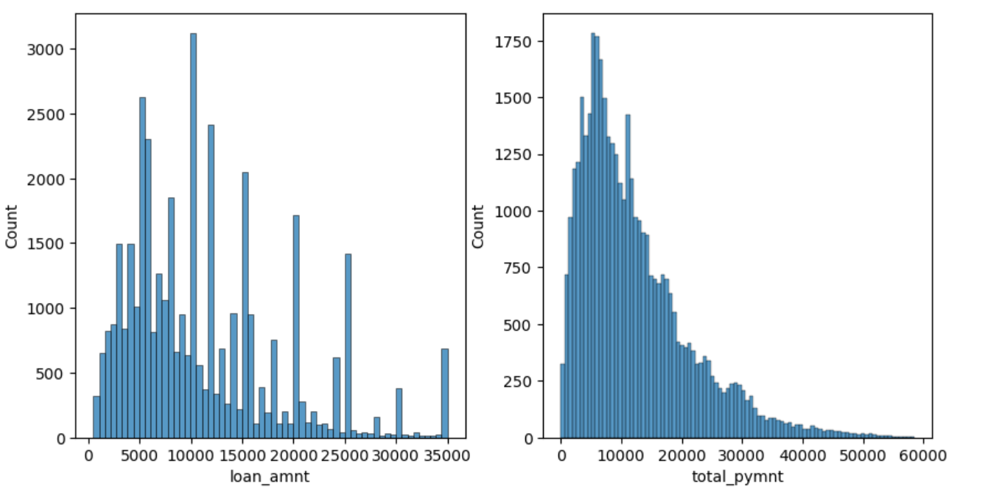
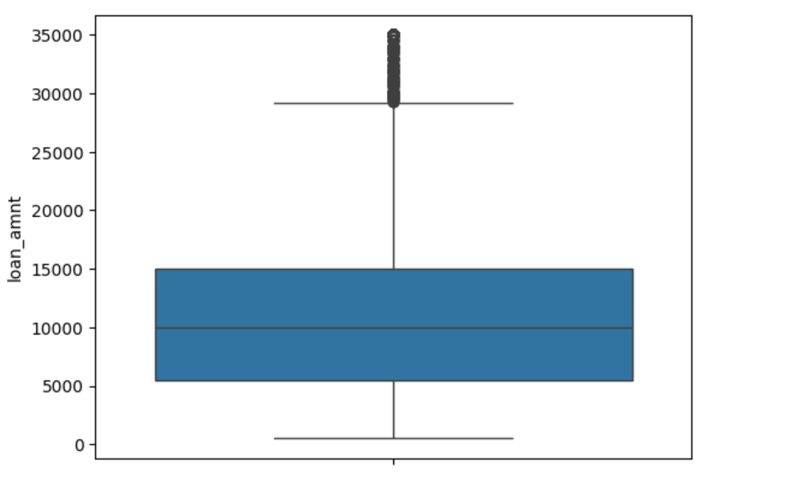
Data Cleaning
Plotted a histogram on quantitative variables like loan amount, total payment and box plot on loan amount.

Slide 6
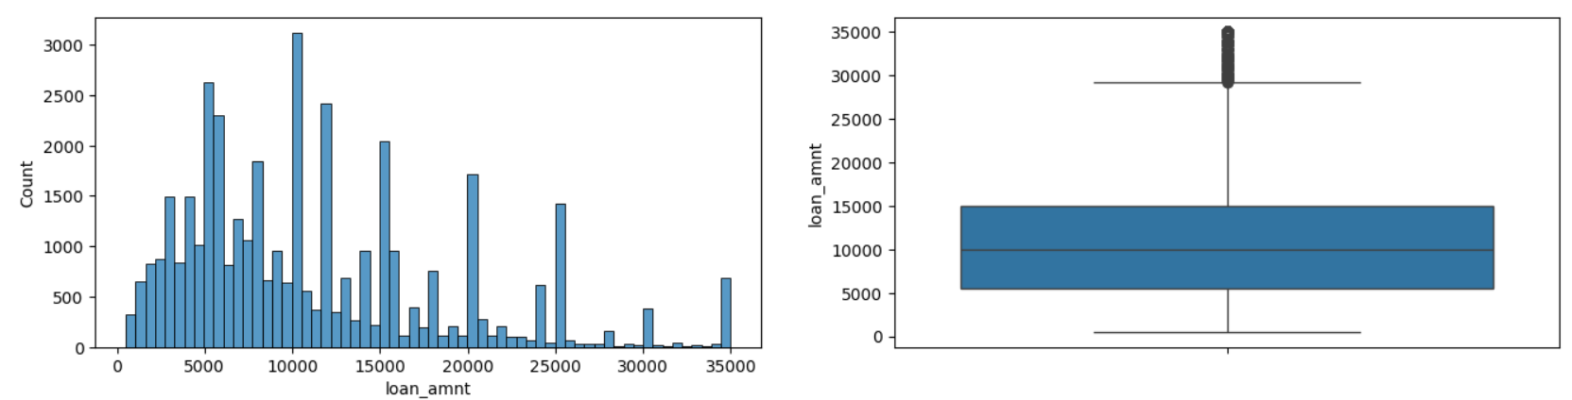
Data Cleaning
Finding out the 25th percentile, 75th percentile using boxplot
Finding out the IQR with the formula : 75th percentile – 25th percentile.
Finding the upper limit and lower limit using below formulas: upper_limit= percentile75 + 1.5 * iqr lower_limit= percentile25 + 1.5 * iqr
Finding the outliers by comparing with upper limit and lower limit.
Removing the outliers.

Slide 7
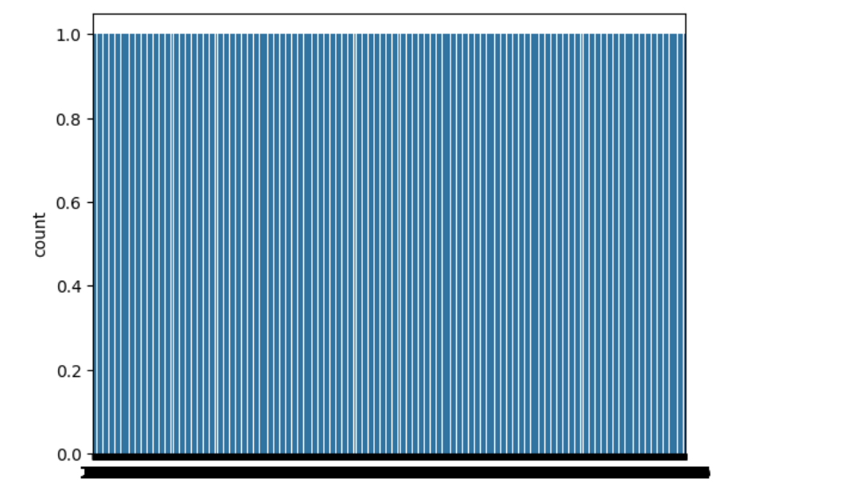
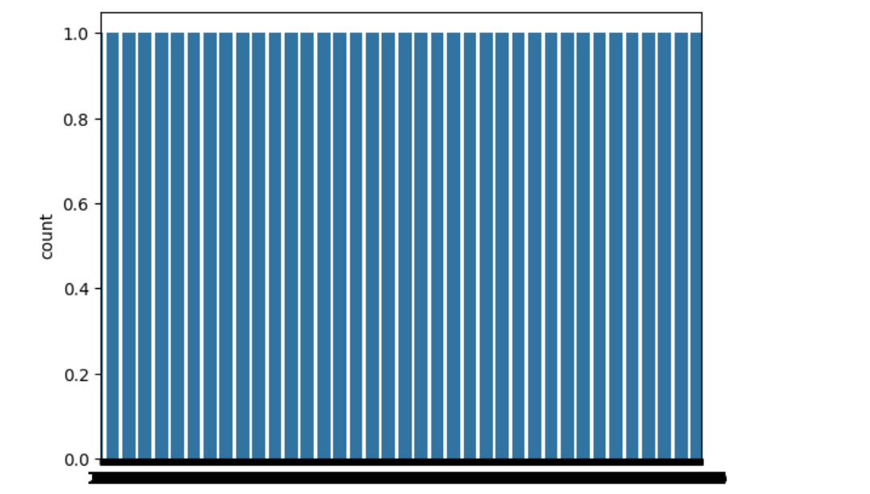
Univariate analysis
Countplot on loan amount and total payment graphs are created.
Loan amount Total payment

Slide 8
Univariate analysis
In order to manage the data, we can drop the current columns as applicant is in the process of paying the installment.
Here current customer cannot be treated as default customer.
Charged off customers who have not paid one loan even after the due date will be considered as defaulted.
By using the count plot verified, the verification status.
Current and Fully paid column data are removed.

Slide 9
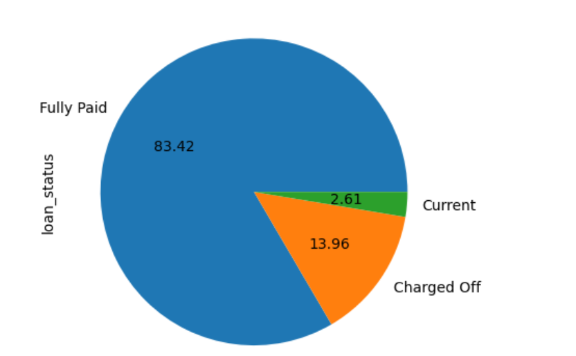
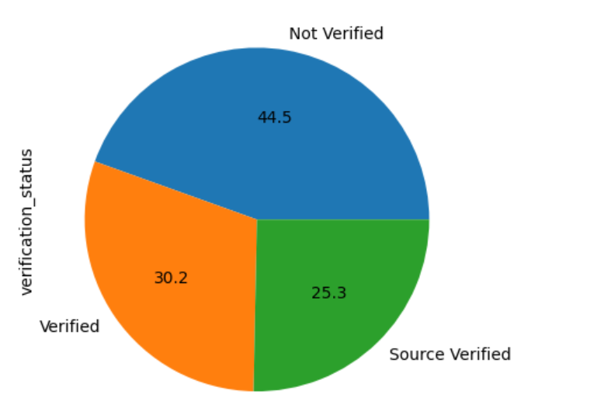
Univariate analysis
Pie Chart with fully paid, current and charged off customers. Pie Chart with verification status.

Slide 10
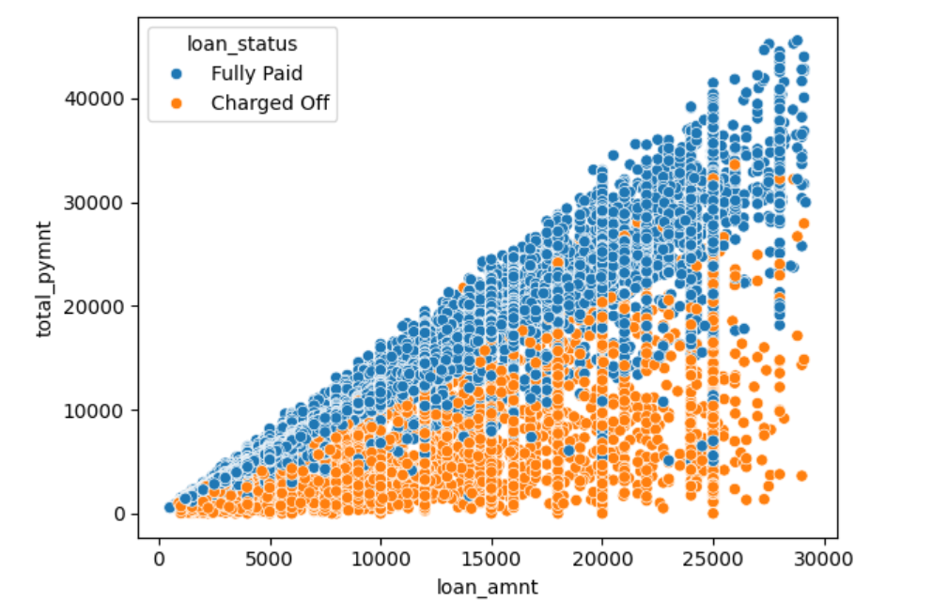
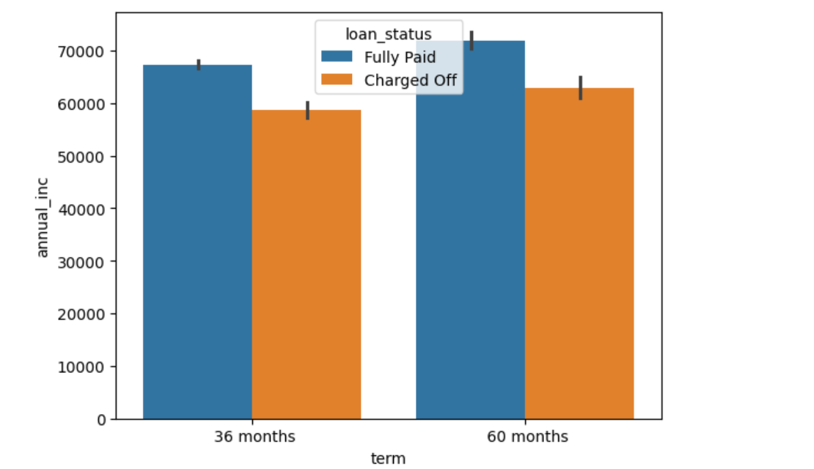
Results
Scatterplot on loan status Barplot on loan status with annual income in y a axis and term in x axis.

Slide 11
Results
total_pymnt and total_pymnt_inv: Strong correlation indicates that the total payment made by borrowers closely matches the total payment expected by investors.
¶int_rate and grade: If grade is numerical, a strong negative correlation would suggest that lower grades (higher risk) are associated with higher interest rates.
installment and loan_amnt: Strong positive correlation indicates that the installment amount is closely related to the loan amount.int_rate and annual_inc: A weak correlation here might suggest that interest rates are not strongly influenced by annual
income alone.loan_amnt and funded_amnt: High positive correlation suggests that the amount loaned (loan_amnt) is strongly related to the amount funded (funded_amnt).Strong correlation between int_rate and loan_status can help in setting higher interest rates for riskier applicants to mitigate potential losses.Strong correlations like loan_amnt and funded_amnt can be use to streamline the loan funding process.

Slide 12
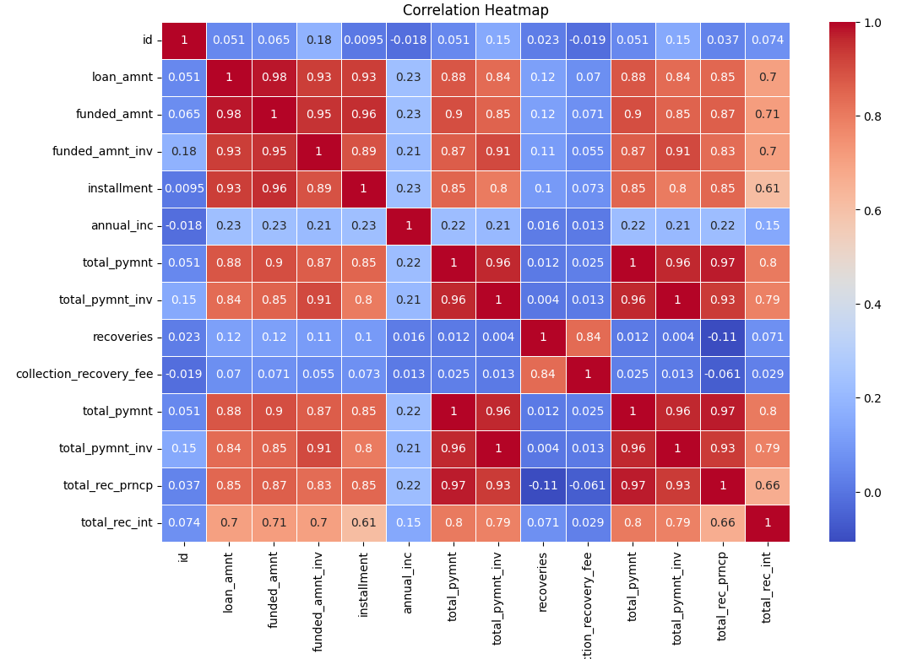
Results

Slide 13
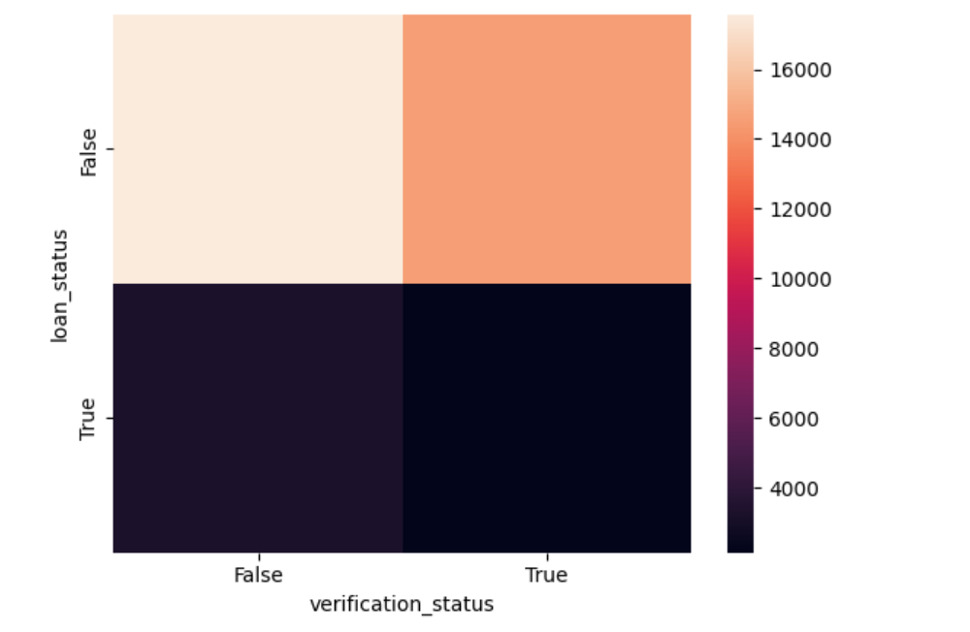
Results
. 17566 customers verification status is Verified whereas 14541 customers Verification status as "Not Verified“ while a lack of verification might be a red flag for potential issues.
By observing the heat map of line no 230 we can say Customers from "Charged off" loan status who is not verified are maximum above 4000 loan_amount

Slide 14
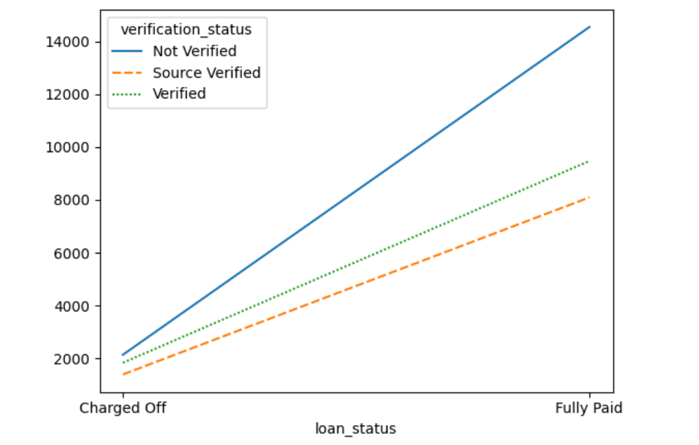
Conclusion
As per the below graph we can say Charged off customers who are "Not verified" have linear growth with the increasing loan amount.

